Slide 1
Lecture 4
Operations & Codes
CME 2003
Digital Logic
Şerife SUNGUN

Slide 2
ARITHMETIC OPERATIONS
WITH SIGNED NUMBERS
Addition
  Both numbers positive
  Positive number with magnitude larger than negative number
  Negative number with magnitude larger than positive number
  Both numbers negative
DEU CSE
Şerife SUNGUN

Slide 3
… Addition
Both numbers positive:
    00000111
    00000100
    00001011
Addition of two positive numbers yields a positive number.
DEU CSE
Şerife SUNGUN

Slide 4
… Addition
Positive number with magnitude larger than negative number:
        00001111
        11111010
      1 00001001
Addition of a positive number and a smaller negative number yields a positive number.
Discard carry
DEU CSE
Şerife SUNGUN

Slide 5
… Addition
Negative number with magnitude larger than positive number:
      00010000
      11101000
      11111000
Addition of a positive number and a larger negative number yields a negative number in 2's complement.
DEU CSE
Şerife SUNGUN

Slide 6
… Addition
Both numhers negative:
      11111011
      11110111
      1 11110010
Addition of two negative numbers yields a negative number in 2's complement.
Discard carry
DEU CSE
Şerife SUNGUN

Slide 7
Overflow Condition
an overflow results as indicated by an incorrect sign bit when two positive or two negative numbers are added.
      01111101 11011101
    + 00111010 + 10001101
      10110111 01101010
Sign incorrect
Magnitude incorrect
overflow
overflow
DEU CSE
Şerife SUNGUN

Slide 8
Subtraction
To subtract two signed numbers,
  take the 2's complement of the subtrahend
  add.
  Discard any final carry bit.
  8 - 3 = 8 + (-3) = 5.
      00001000 00001000
      - 11111101 + 11111101
      1 00000101
Discard carry
DEU CSE
Şerife SUNGUN

Slide 9
Multiplication
Methods of Multiplication :
  direct addition method.
  partial products method
8 Multiplicand
x 3 Multiplier
24 Product
DEU CSE
Şerife SUNGUN

Slide 10
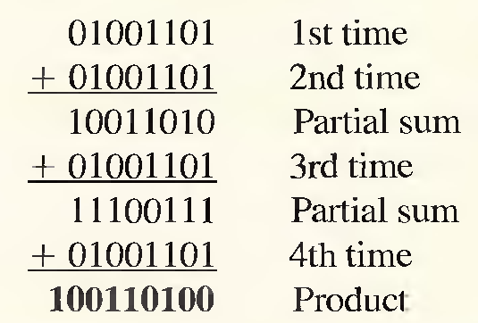
direct addition method
Multiplication is equivalent to adding a number to itself a number of times equal to the multiplier.
Example:
Multiply the signed binary numbers: 01001101 (multiplicand) and 00000100
(multiplier) using the direct addition method.
DEU CSE
Şerife SUNGUN

Slide 11
The partial products method
The multiplicand is multiplied by each multiplier digit beginning with the least significant digit.
The result of the multiplication of the multiplicand by a multiplier digit is called a partial product.
Each successive partial product is moved (shifted) one place to the left and when all the partial products have been produced, they are added to get the final product.
DEU CSE
Şerife SUNGUN

Slide 12
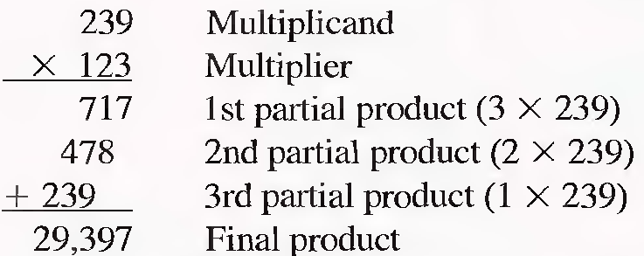
… the partial products method
Example:
DEU CSE
Şerife SUNGUN

Slide 13
The basic steps in the partial products method
Step 1: Determine if the signs of the multiplicand and multiplier are the same or different. This determines what the sign of the product will be.
  If the signs are the same, the product is positive.
  If the signs are different, the product is negative.
DEU CSE
Şerife SUNGUN

Slide 14
… the basic steps in the partial products method
Step 2: Change any negative number to true (uncomplemented) form. Because most computers store negative numbers in 2's complement, a 2's complement operation is required to get the negative number into true form.
Step 3. Starting with the least significant multiplier bit, generate the partial products. When the multiplier bit is 1, the partial product is the same as the multiplicand. When the multiplier bit is 0, the partial product is zero. Shift each successive partial product one bit to the left.
DEU CSE
Şerife SUNGUN

Slide 15
… the basic steps in the partial products method
Step 4: Add each successive partial product to the sum of the previous partial products to get the final product.
Step 5: If the sign bit that was determined in step 1 is negative. take the 2's complement of the product. If positive, leave the product in true form. Attach the sign bit to the product.
DEU CSE
Şerife SUNGUN

Slide 16
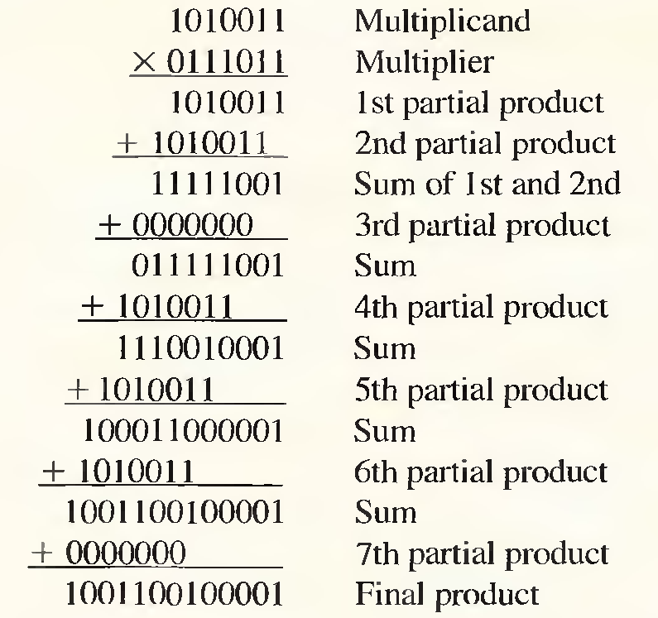
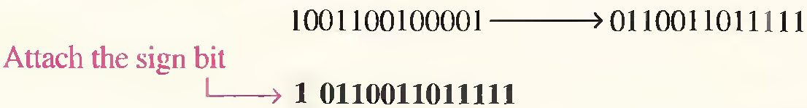
Example
01010011 x 11000101 = ?
x 00111011
2’s complement
DEU CSE
Şerife SUNGUN

Slide 17
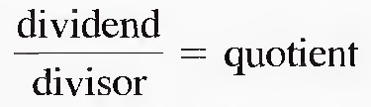
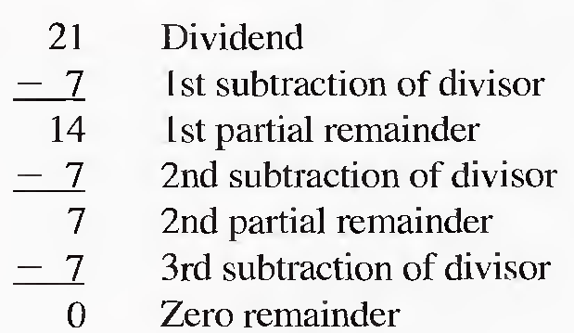
Division
standard division format:
The division operation in computers is accomplished using subtraction.
DEU CSE
Şerife SUNGUN

Slide 18
The basic steps in a division process
Step 1. Determine if the signs of the dividend and divisor are the same or different. This determines what the sign of the quotient will be. Initialize the quotient to zero.
  If the signs are the same, the quotient is positive.
  If the signs are different, the quotient is negative.
Step 2. Subtract the divisor from the dividend using 2's complement addition to get the first partial remainder and add 1 to the quotient. If this partial remainder is positive, go to step 3. If the partial remainder is zero or negative, the division is complete.
Step 3. Subtract the divisor from the partial remainder and add 1 to the quotient. If the result is positive, repeat for the next partial remainder. If the result is zero or negative, the division is complete.
DEU CSE
Şerife SUNGUN

Slide 19
Example:
Divide 01100100 by 00011001.
Step 1: The signs of both numbers are positive, so the quotient will be positive. The quotient is initially zero: 00000000.
Step 2: Subtract the divisor from the dividend using 2’s complement addition (remember that final carries are discarded).
01100100 Dividend
+ 11100111 2's complement of divisor
01001011 Positive 1st partial remainder
Add 1 to quotient: 00000000 + 00000001 = 00000001
DEU CSE
Şerife SUNGUN

Slide 20
… example
Step 3: Subtract the divisor from the 1st partial remainder using 2's complement addition.
01001011 1st partial remainder
+ 11100111 2's complement of divisor
00110010 Positive 2nd partial remainder
DEU CSE
Şerife SUNGUN

Slide 21
… example
Step 4: Subtract the divisor from the 2nd partial remainder using 2's complement addition.
00110010 2nd partial remainder
+ 11100111 2's complement of divisor
00011001 Positive 3rd partial remainder
Add 1 to quotient:
00000010 + 00000001 = 00000011.
DEU CSE
Şerife SUNGUN

Slide 22
… example
Step 5: Subtract the divisor from the 3rd partial remainder using 2's complement addition.
00011001 3rd partial remainder
+ 11100111 2's complement of divisor
00000000 Zero remainder
Add 1 to quotient:
00000011 + 00000001 = 00000100 (final quotient).
The process is complete.
DEU CSE
Şerife SUNGUN

Slide 23
HEXADECIMAL NUMBERS
The hexadecimal number system has
  a base of 16
  consists of digits 0-9 and letters A-F.
DEU CSE
Şerife SUNGUN

Slide 24
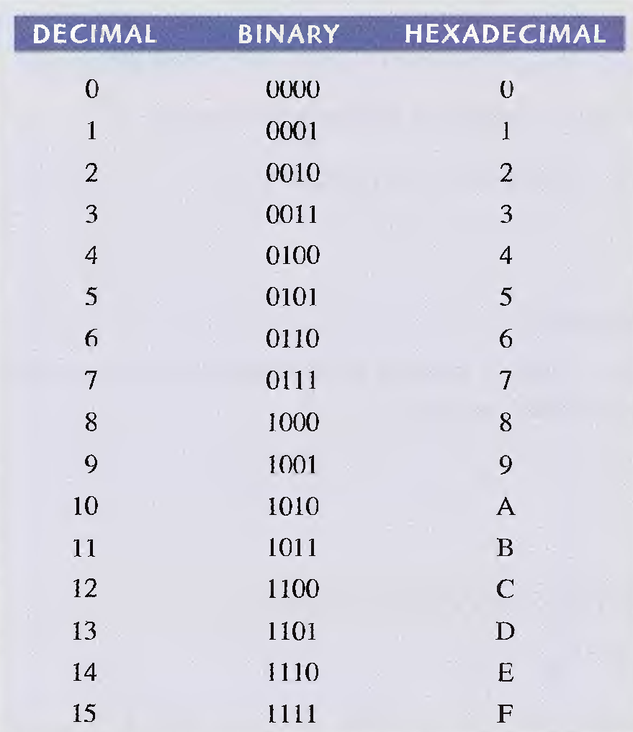
…HEXADECIMAL NUMBERS
DEU CSE
Şerife SUNGUN

Slide 25
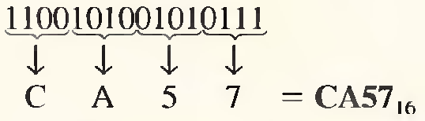
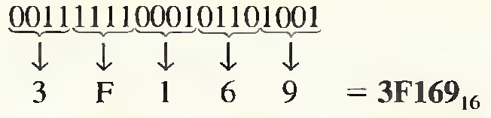
Binary-to-Hexadecimal Conversion
break the binary number into 4-bit groups
starting at the right-most bit
replace each 4-bit group with the equivalent hexadecimal
Example:
Convert the following binary numbers to hexadecimal:
(a) 100101001010111 (b) 111111000101101001
DEU CSE
Şerife SUNGUN

Slide 26
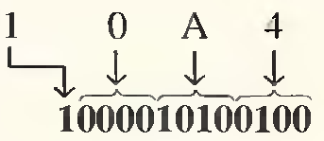
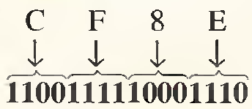
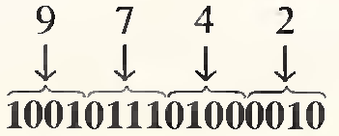
Hexadecimal-to-Binary Conversion
replace each hexadecimal symbol with the appropriate four bits.
Example:
Determine the binary numbers for the following hexadecimal numbers:
(a) 10A4 (b) CF8E (c) 9742
DEU CSE
Şerife SUNGUN

Slide 27
Hexadecimal-to-Decimal Conversion
multiply the decimal value of each hexadecimal digit by its weight and take the sum of these products.
The weights of a hexadecimal number are increasing powers of 16 (from right to left).
16 ³ 16 ² 16 ¹ 16⁰
4096 256 16 1
Example: E516 = ( ? )₁₀
    E516 = (E x 16) + (5 x 1) = (14x 16) + (5 x1)
    = 224 + 5
    = ( 229 )₁₀
DEU CSE
Şerife SUNGUN

Slide 28
Decimal-to-Hexadecimal Conversion
repeated division of a decimal number by 16 will produce the equivalent hexadecimal number, formed by the remainders of the divisions.
the first remainder produced is the least significant digit
when a quotient has a fractional part, the fractional part is multiplied by the divisor to get the remainder.
DEU CSE
Şerife SUNGUN

Slide 29
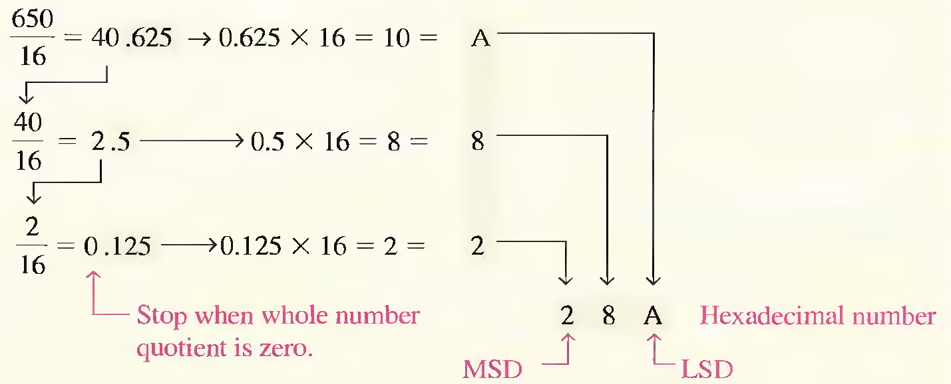
Example
Convert the decimal number 650 to hexadecimal.
DEU CSE
Şerife SUNGUN

Slide 30
Hexadecimal Addition
When adding two hexadecimal numbers, use the following rules.
  In any given column of an addition problem, think of the two hexadecimal digits in terms of their decimal values.
      For instance,
      5 ₁₆ = 5₁₀ and C ₁₆ = 12₁₀
  If the sum of these two digits is 15₁₀ or less, bring down the corresponding hexadecimal digit.
  If the sum of these two digits is greater than 15₁₀, bring down the amount of the sum that exceeds 16₁₀ and carry a 1 to the next column.
DEU CSE
Şerife SUNGUN

Slide 31
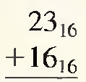
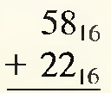

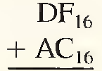




example
Add the following hexadecimal numbers:
DEU CSE
Şerife SUNGUN

Slide 32
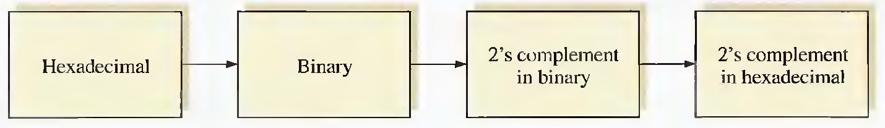
Hexadecimal Subtraction - Method 1
Convert the hexadecimal number to binary.
Take the 2's complement of the binary number.
Convert the result to hexadecimal.
Example:
2A
00101010
11010110
D6
DEU CSE
Şerife SUNGUN

Slide 33
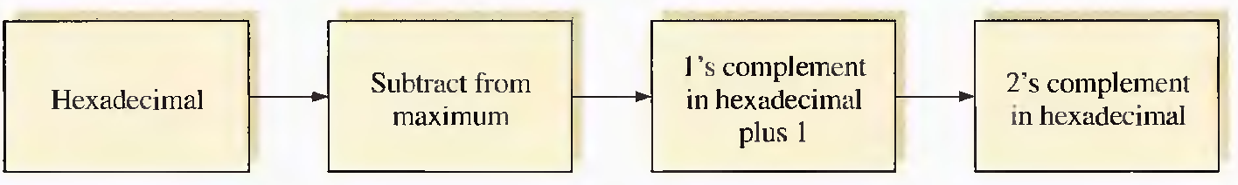
Hexadecimal Subtraction - Method 2
Subtract the hexadecimal number from the maximum hexadecimal number and add .
Example:
2A
FF – 2A
D5 + 1
D6
DEU CSE
Şerife SUNGUN

Slide 34
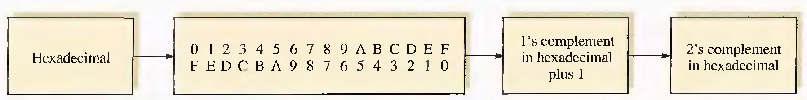
Hexadecimal Subtraction - Method 3
Write the sequence of single hexadecimal digits.
Write the sequence in reverse below the forward sequence.
The 1's complement of each hex digit is the digit directly below it.
Add 1 to the resulting number to get the 2's complement.
DEU CSE
Şerife SUNGUN

Slide 35
Example
2A
0 1 2 3 4 5 6 7 8 9 A B C D E F
F E D C B A 9 8 7 6 5 4 3 2 1 0
D5 + 1
D6
84
- 2A
84
+D6
84 ₁₆ - 2A ₁₆ = ?
Result : 5A
Drop carry
1 5A
DEU CSE
Şerife SUNGUN

Slide 36
example
C3₁₆ - 0B ₁₆ = ?
0B₁₆ = 00001011
2's complement of 0B₁₆ = 11110101
= F5₁₆ (using Method 1)
C3
+ F5 Add
1B6 Drop carry
The difference is B6.
DEU CSE
Şerife SUNGUN

Slide 37
OCTAL NUMBERS
The octal number system is composed of eight digits:
0, I, 2, 3, 4, 5, 6, 7
DEU CSE
Şerife SUNGUN

Slide 38
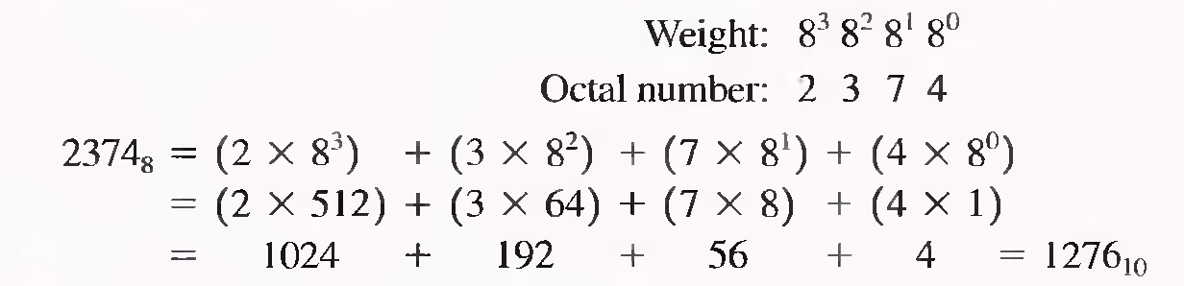
Octal-to-Decimal Conversion
each successive digit position is an increasing power of eight, beginning in the right-most column with 8°.
Example:
DEU CSE
Şerife SUNGUN

Slide 39
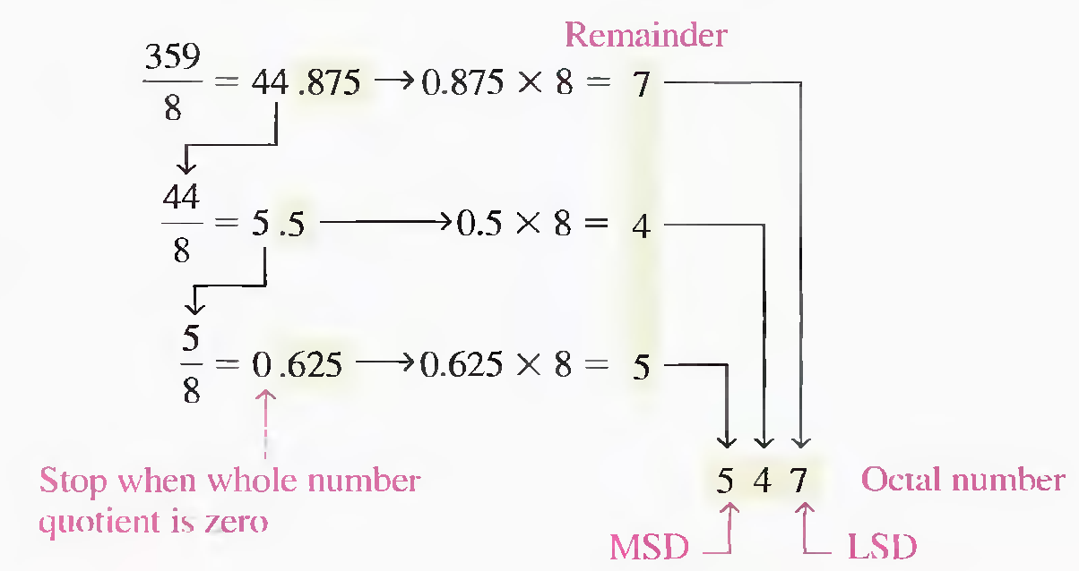
Decimal-to-Octal Conversion
Each successive division by 8 yields a remainder that becomes a digit in the equivalent octal number.
The first remainder generated is the least significant digit (LSD).
DEU CSE
Şerife SUNGUN

Slide 40
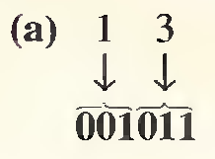
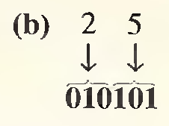
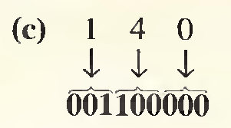
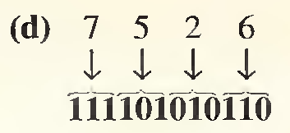
Octal-to-Binary Conversion
Because each octal digit can be represented by a 3-bit binary number
Example: Convert each of the following octal numbers to binary:
(a) 13 ₈ (b) 25 ₈ (c) 140 ₈ (d) 7526 ₈
DEU CSE
Şerife SUNGUN

Slide 41
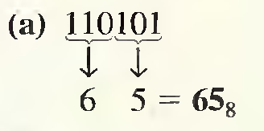
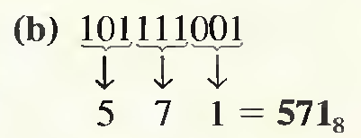
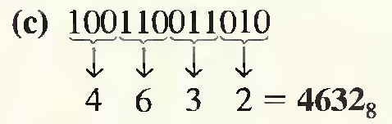
Binary-to-Octal Conversion
Example:
Convert each of the following binary numbers to octal:
(a) 1101O1 (b) 101111O01 (c) 100110011010
DEU CSE
Şerife SUNGUN

Slide 42
BINARY CODED DECIMAL (BCD)
The 8421 Code
  each decimal digit, 0 through 9, is epresented by a binary code of four bits.
  The designation 8421 indicates the binary weights of the four bits (2 ³ , 2 ² , 2 ¹ , 2 ⁰ )
DEU CSE
Şerife SUNGUN

Slide 43
… The 8421 Code
Invalid Codes
sixteen numbers (0000 through 1111) can be represented with 4 bits but in the 8421 code only ten of these are used.
The invalid six code :
  1010, 1011, 1100, 1101, 1110, and 1111
DEU CSE
Şerife SUNGUN

Slide 44
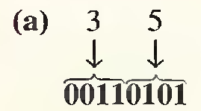
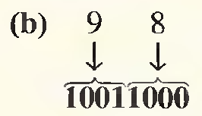
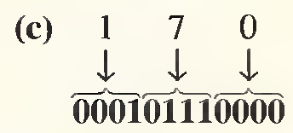
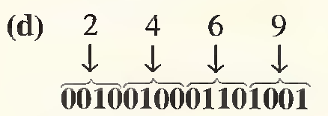
Example
Convert each of the following decimal numbers to BCD:
(a) 35 (b) 98 (c) 170 (d) 2469
DEU CSE
Şerife SUNGUN

Slide 45
Example
Convert each of the following BCD codes to decimal:
10000110
001101010001
(c) 1001010001110000
86
351
9470
DEU CSE
Şerife SUNGUN

Slide 46
BCD Addition
Step 1. Add the two BCD numbers, using the rules for binary addition.
Step 2. If a 4-bit sum is equal to or less than 9, it is a valid BCD number.
Step 3. If a 4-bit sum is greater than 9, or if a carry out of the 4-bit group is generated,it is an invalid result.
  Add 6 (0110) to the 4-bit sum in order to skip the six invalid states.
  If a carry results when 6 is added. simply add the carry to the next 4-bit group.
DEU CSE
Şerife SUNGUN

Slide 47
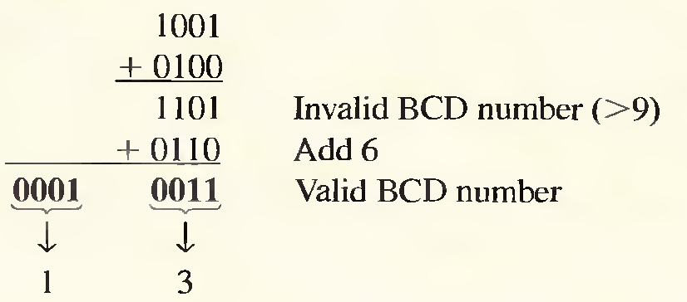
Example
Addition of the BCD numbers
DEU CSE
Şerife SUNGUN

Slide 48
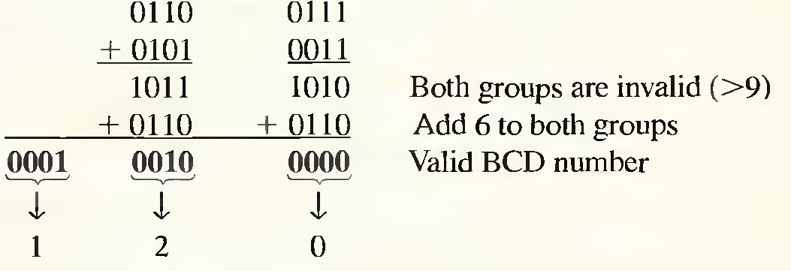
example
Addition of the BCD numbers
DEU CSE
Şerife SUNGUN

Slide 49
DIGITAL CODES
The Gray Code
  The Gray code is unweighted and is not an arithmetic code
  weights assigned to the bit positions.
  only a single bit change from one code word to the next in sequence.
  the Gray code can have any number of bits.
DEU CSE
Şerife SUNGUN

Slide 50
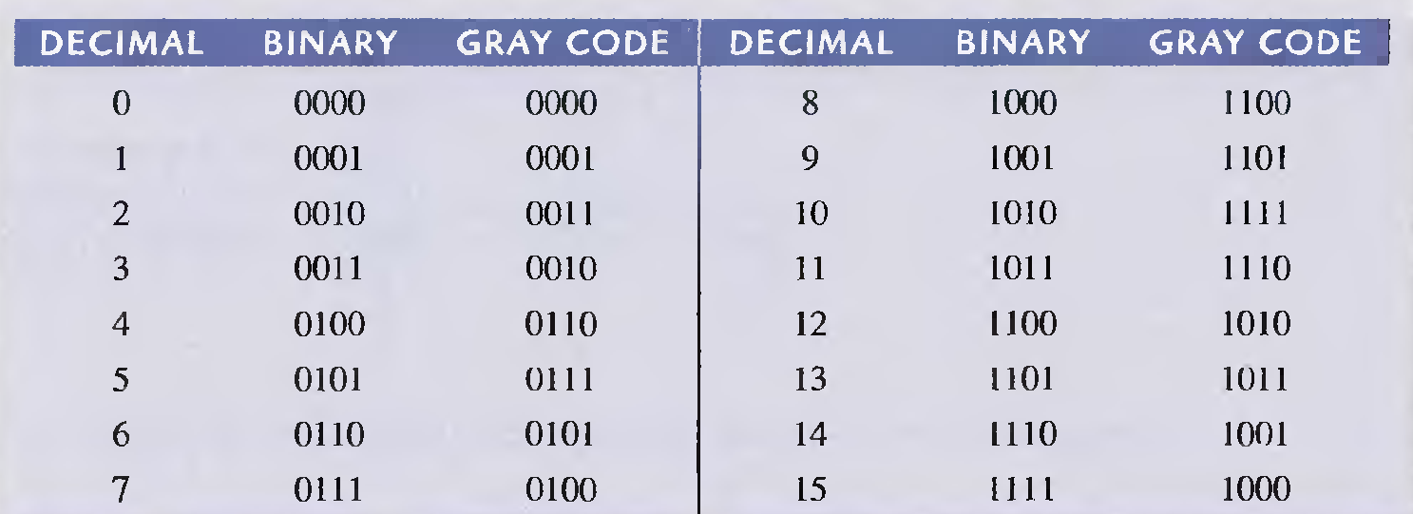
… gray code
DEU CSE
Şerife SUNGUN

Slide 51
Binary-to-Gray Code Conversion
The most significant bit (left-most) in the Gray code is the same as the corresponding MSB in the binary number.
Going from left to right, add each adjacent pair of binary code bits to get the next Gray code bit. Discard carries.
DEU CSE
Şerife SUNGUN

Slide 52
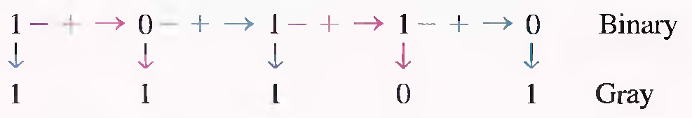
example
the conversion of the binary number 10110 to Gray code :
The Gray code is 11101
DEU CSE
Şerife SUNGUN

Slide 53
Gray-to-Binary Conversion
The most significant bit (left-most) in the binary code is the same as the corresponding bit in the Gray code.
Add each binary code bit generated to the Gray code bit in the next adjacent position. Discard carries.
DEU CSE
Şerife SUNGUN

Slide 54
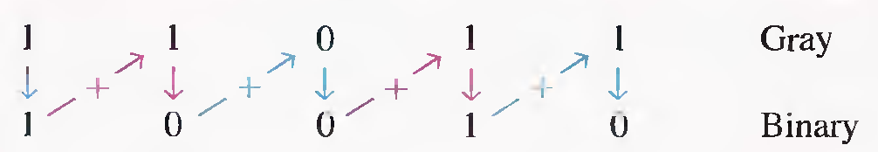
example
the conversion of the Gray code word 11011 to binary
DEU CSE
Şerife SUNGUN

Slide 55
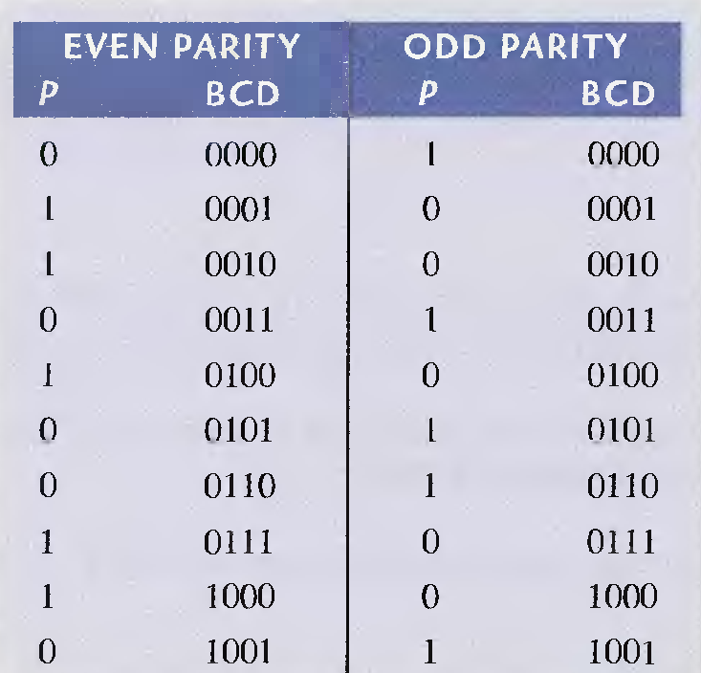
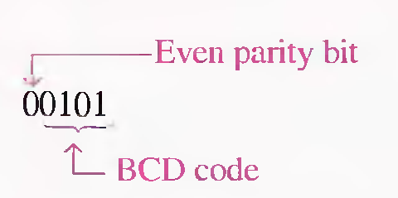
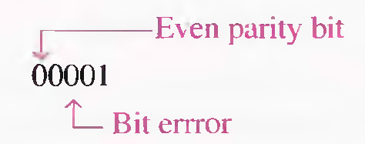
ERROR DETECTION AND CORRECTION CODES
Parity Method
DEU CSE
Şerife SUNGUN

